Slide 1
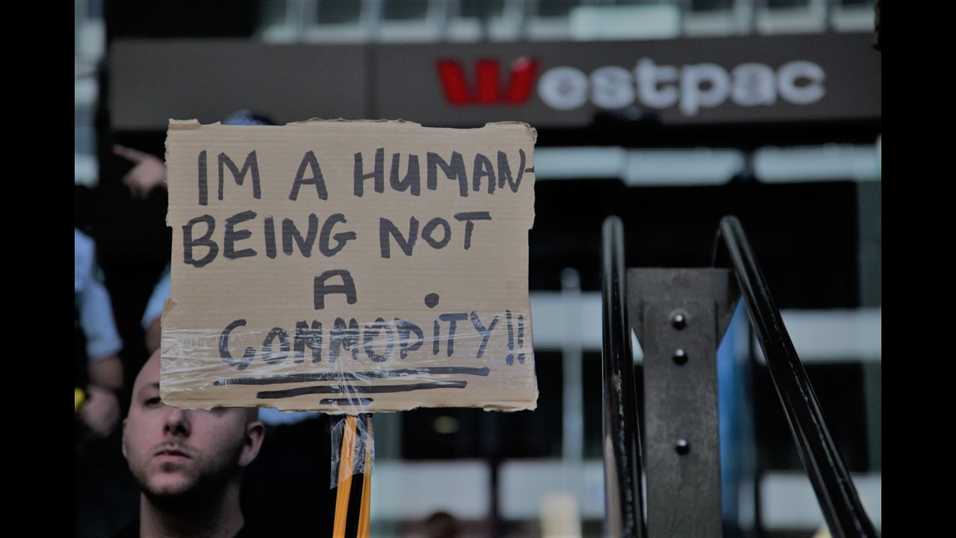
HOW
TO WOW
Marco Gianotten

Slide 2
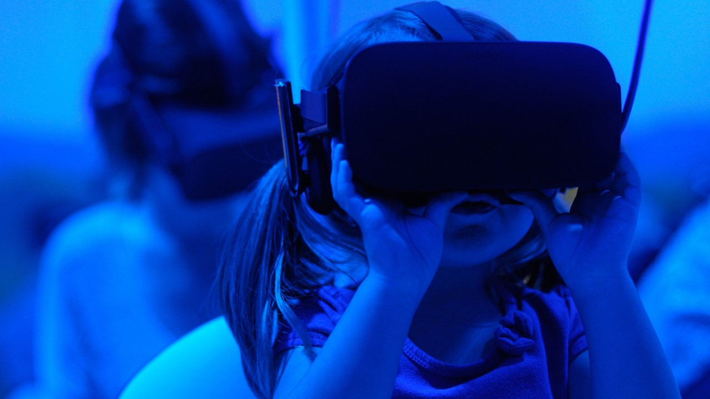
It’s all about experience,
stupid!

Slide 3
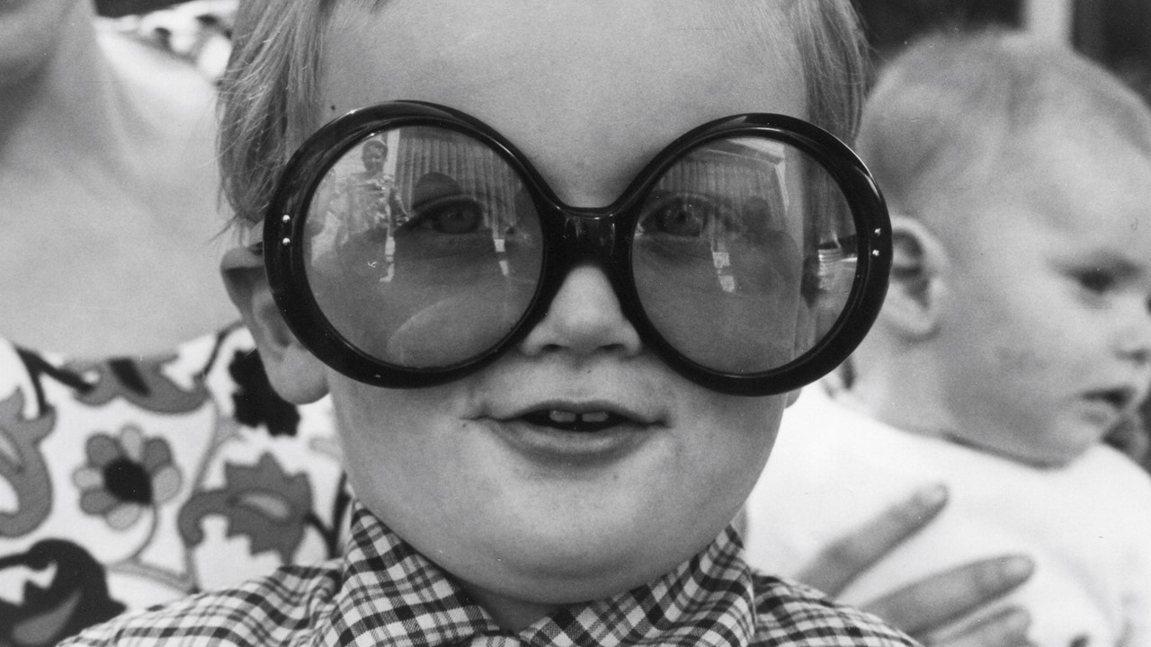
5
Creativity
Curve
Terminal Seriousness
65+
@Marco_Gianotten

Slide 4
Volatility
Uncertainty
VUCA
Complexity
Ambiguity

Slide 5
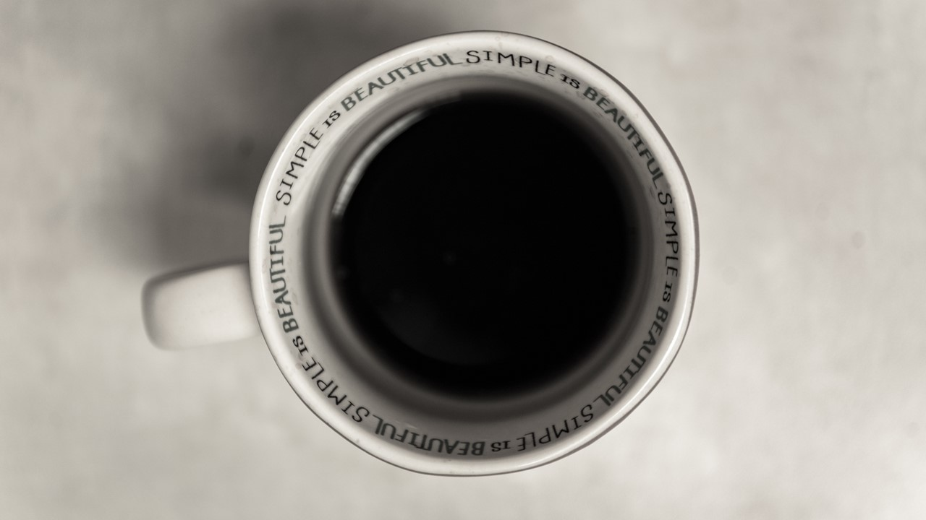
BE HIP
Beauty
Elegance
Happiness
Inclusion
Purpose

Slide 6
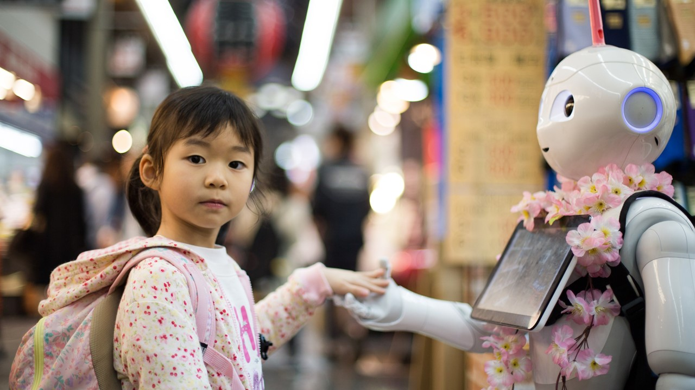
Bring touch into tech
Anthropomorphism. Experiencing technology as if it’s somehow human
Demographic time-bomb. Falling fertility, increasing longevity, shrinking workforce
Emotional requirements. Feel is the new killer app: emotional AI, gamification

Slide 7
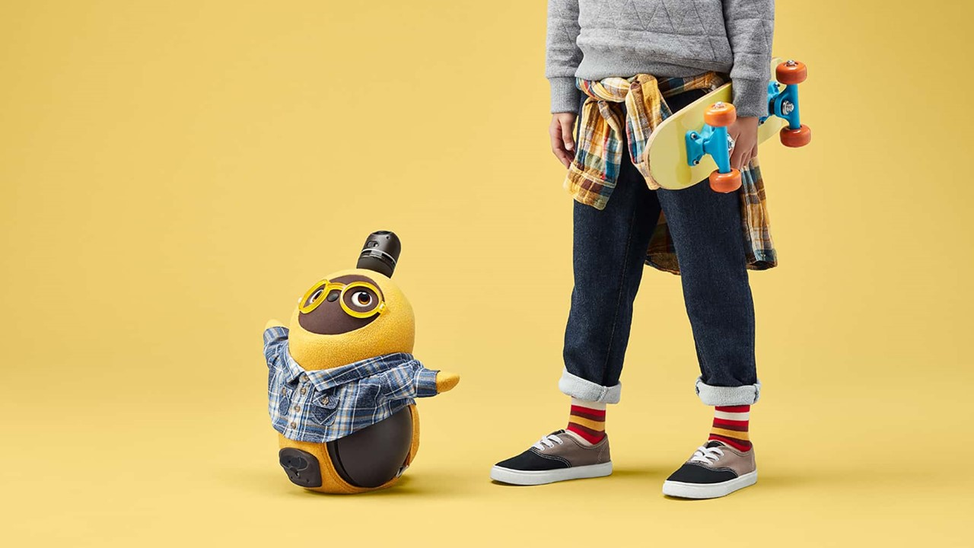
Love + Robot
Lovot

Slide 8
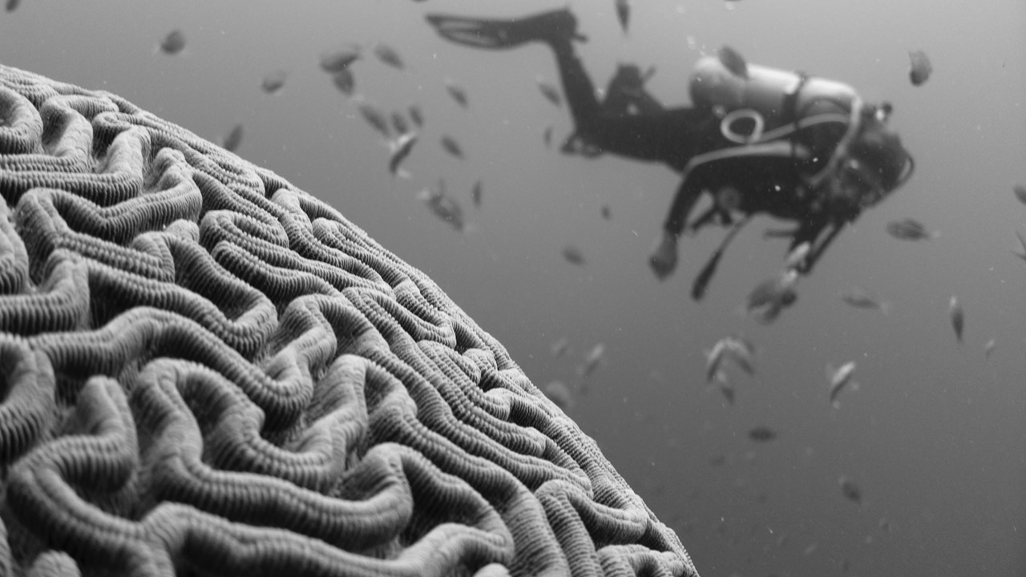
WARNING
Operating System hasn’t been updated for at least 10,000 years. Please handle carefully in
case of disruptive change!
Brain disclaimer

Slide 9
Is IT increasing or reducing work stress?
☐ Increasing
☐ Reducing
Notes:
Holistic – seeing the big picture in relation to details
Empathy – human-centered focus on real needs
Co-creation- iterative approach with stakeholders
Verhoogd of verlaagd IT je werkstress?
Verhoogd
Verlaagd

Slide 10
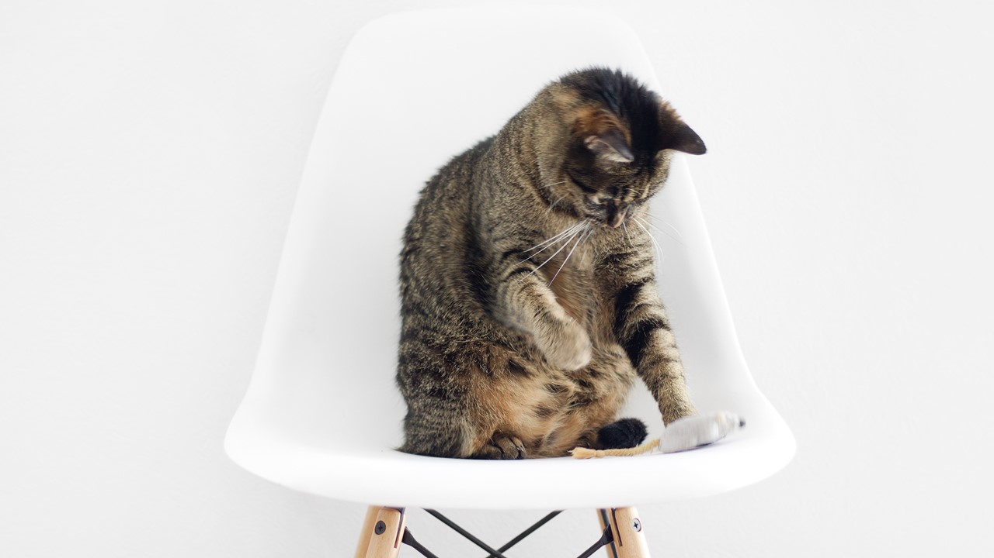
Problem
In
Chair,
Not
In
Computer
PICNIC

Slide 11
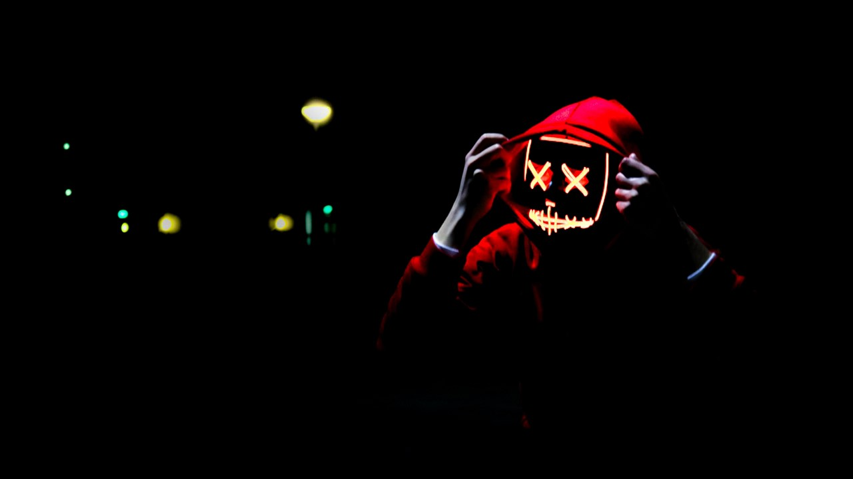
Enterprise IT vs. Online Gaming
Globally over $400 billion is annually
spent on Enterprise IT software
On gaming, consumers already spend over $100 billion per year (mobile, console, PC)
In which industry are users really taken seriously?
In which industry is emotion design ‘business as usual’?

Slide 12
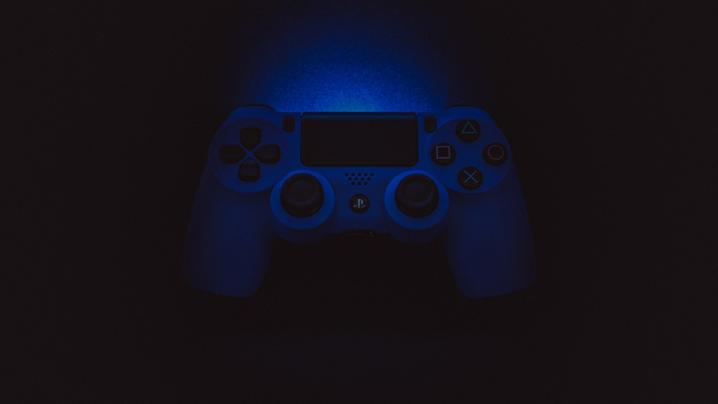
Viewpoint
Menus
Yesj
No
Notes:
Teiyū Gotō is the original designer of the Playstation and the famous controller.

Slide 13
Relevant
Is the application effective in supporting the user’s job?
Confidence
Appealingj
Can the user reach
a level of mastery?
Is the application attractive to the user?
Satisfaction
Is the user happy with the application?

Slide 14
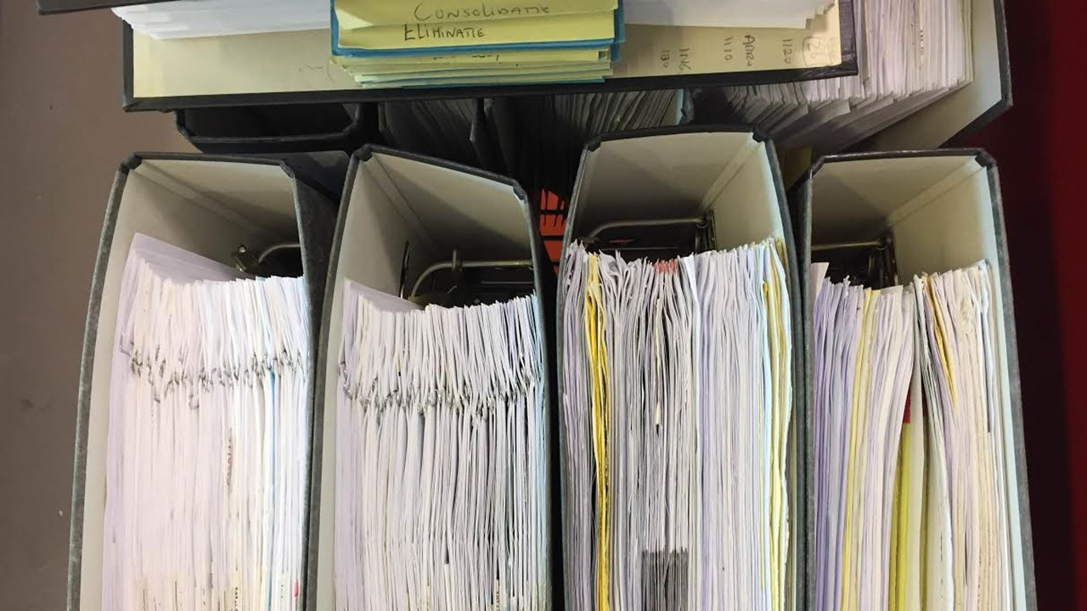
How to prevent being cool…

Slide 15
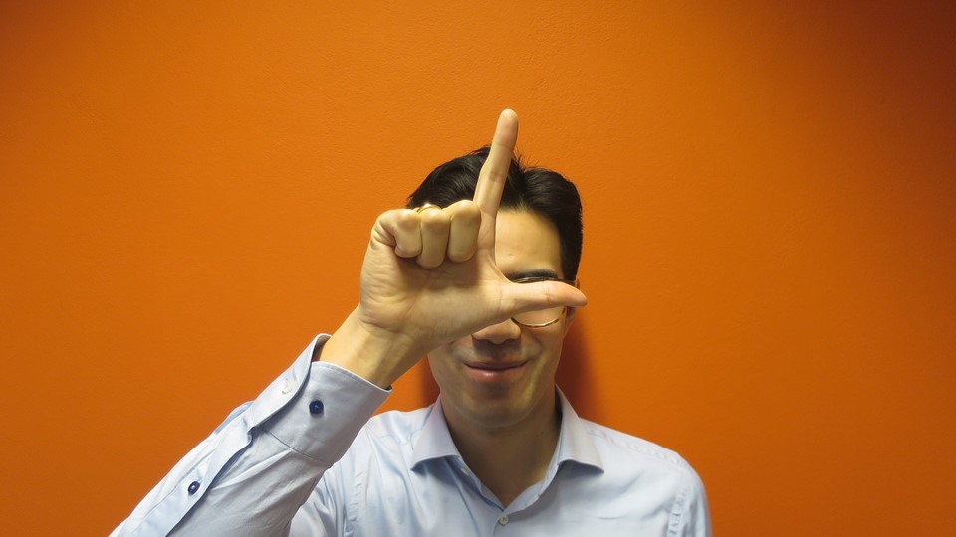
S
A
To the business the acronym SLA often stands for
Secrets, Lies and Assumptions
Notes:
It’s called a Service Level Agreement, but it feels more like a disclaimer than a service commitment. To the business the abbreviation SLA often stands for Secrets, Lies and Assumptions.

Slide 16
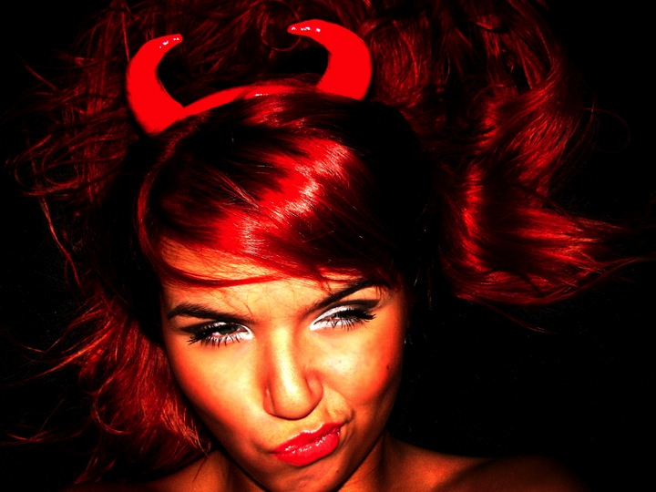
SLAs have nothing to do with the quality experienced
by the user or performance in real business-life
Up to 100Mbps?
Latency smaller than 150ms?
95% Major Incidents resolved in < 4 hours?
90% Minor Changes < 5 workdays?

Slide 17
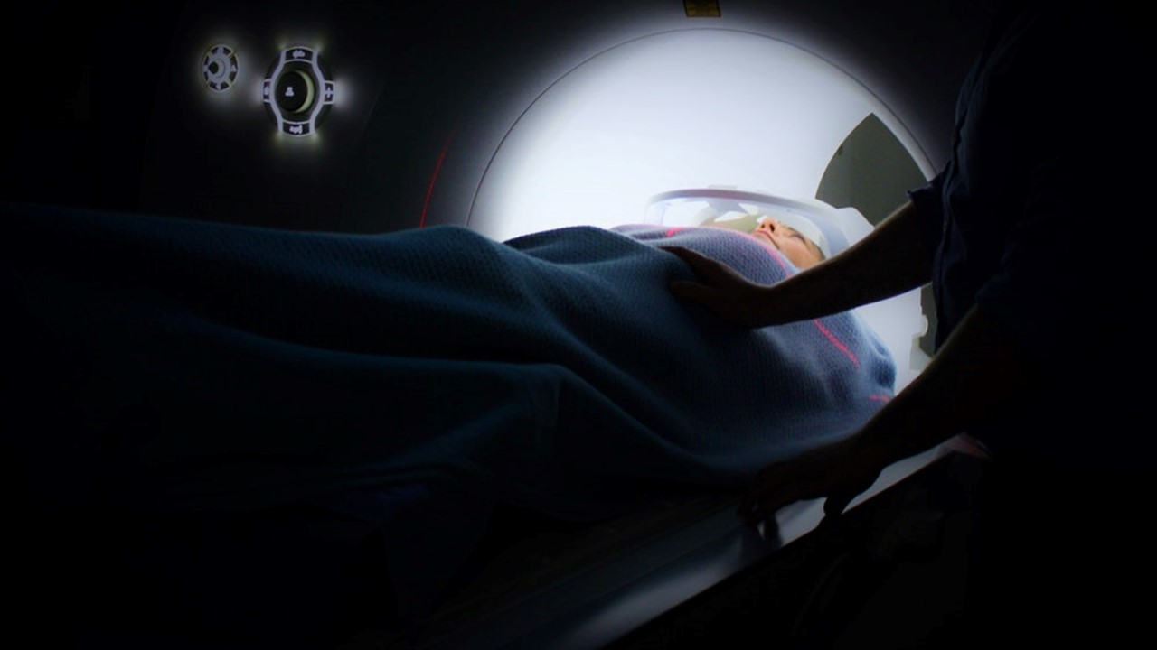
Less than 2% of the 1,958
quality indicators in Healthcare
are patient-reported outcomes
Notes:
Value in Healthcare, World Economic Forum, April 2017
National Quality Measures Clearinghouse of the Agency for Healthcare Research and Quality
Only 32 (less than 2%) are patient-reported outcomes
Patient Reported Outcome Measures (PROM): oe patiënten (het effect van) de behandeling zelf ervaren

Slide 18
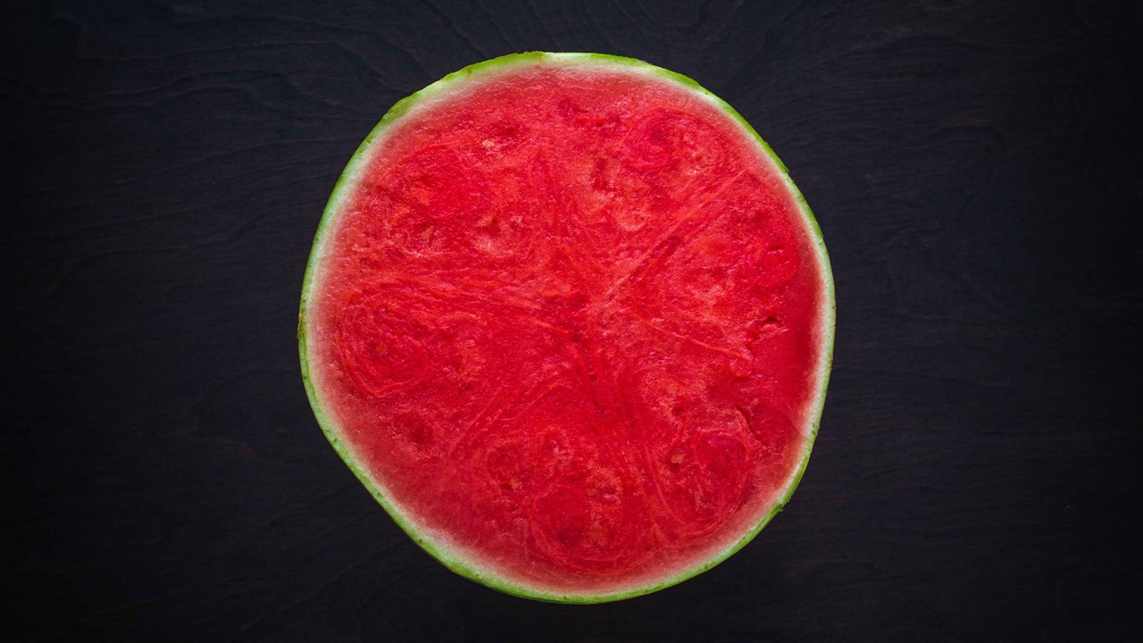
Weapons of Mass Distraction

Slide 19
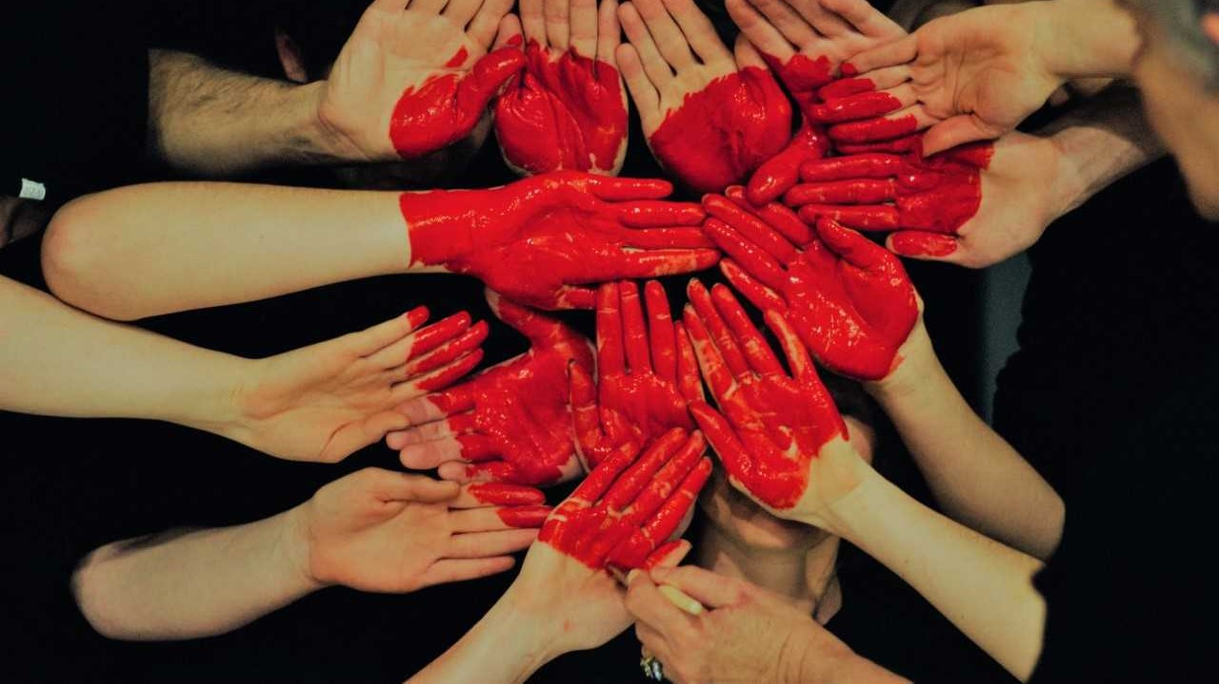
We believe tech
and touch are
yin and yang: complementary forces, not opposing
Xperience Level Agreements

Slide 20
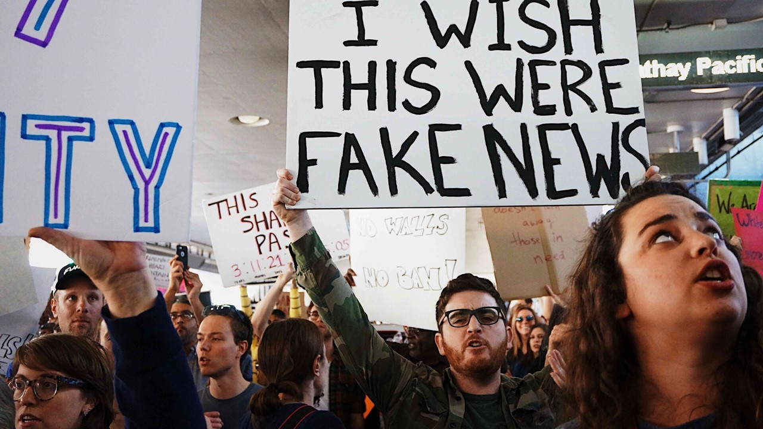
What’s reality?

Slide 21
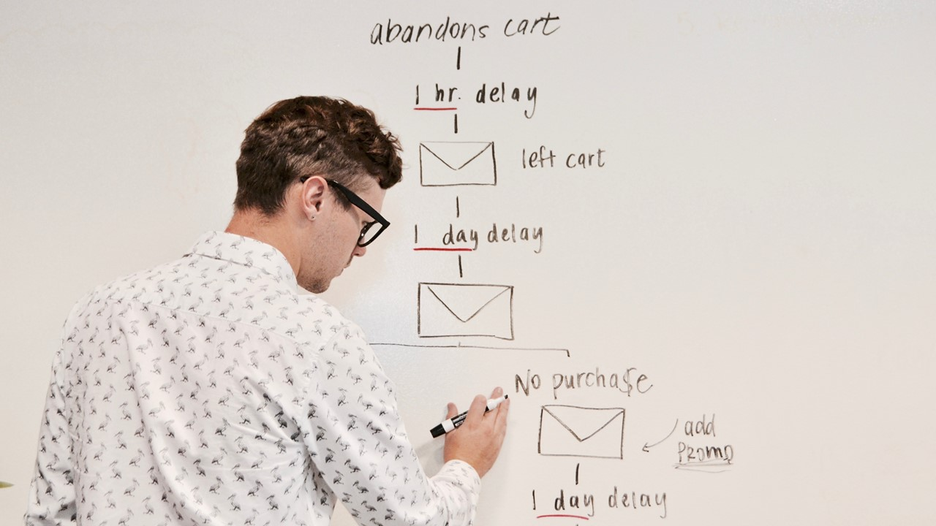
Impact First,
Process Second

Slide 22
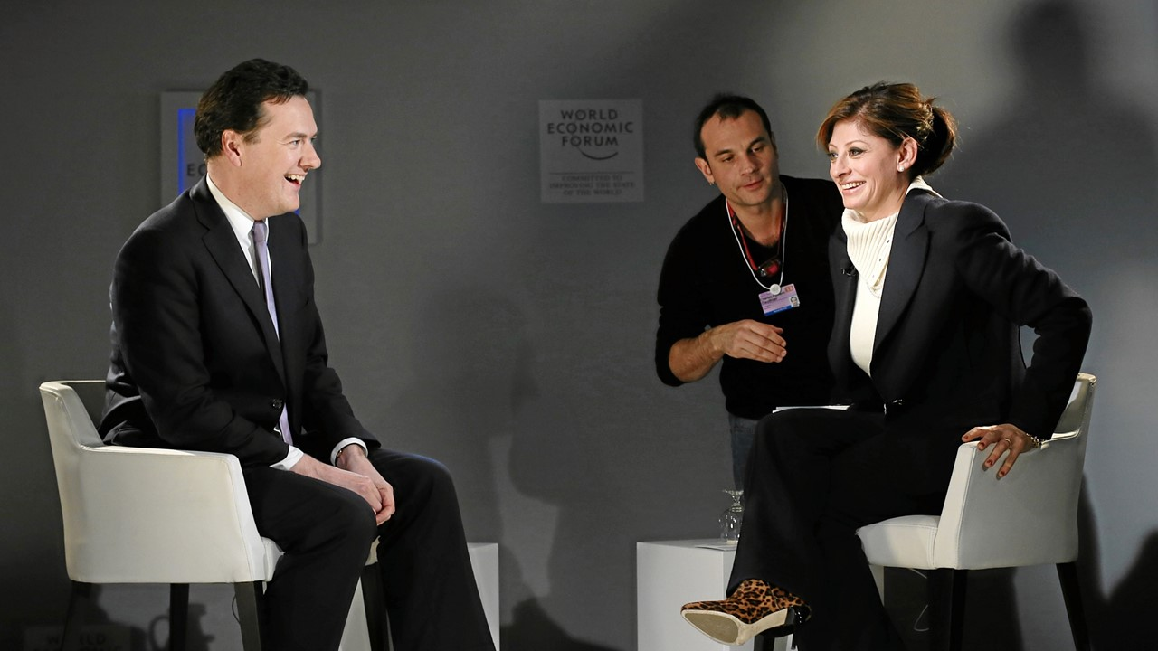
Can you be more specific??
Huh?
…I want an output-based ecosystem, managing performance end-to-end…

Slide 23
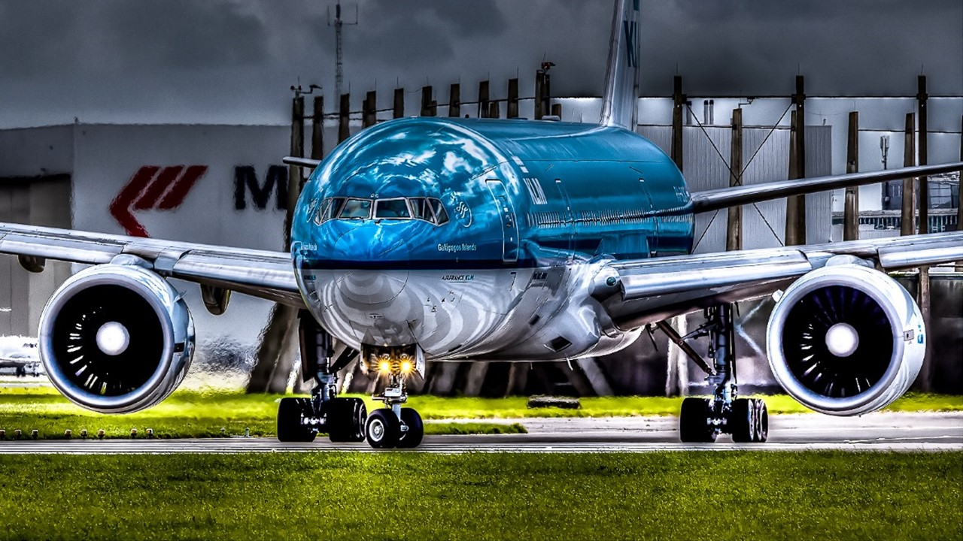
Flight delays due to IT
Above the wing
Below the wing

Slide 24
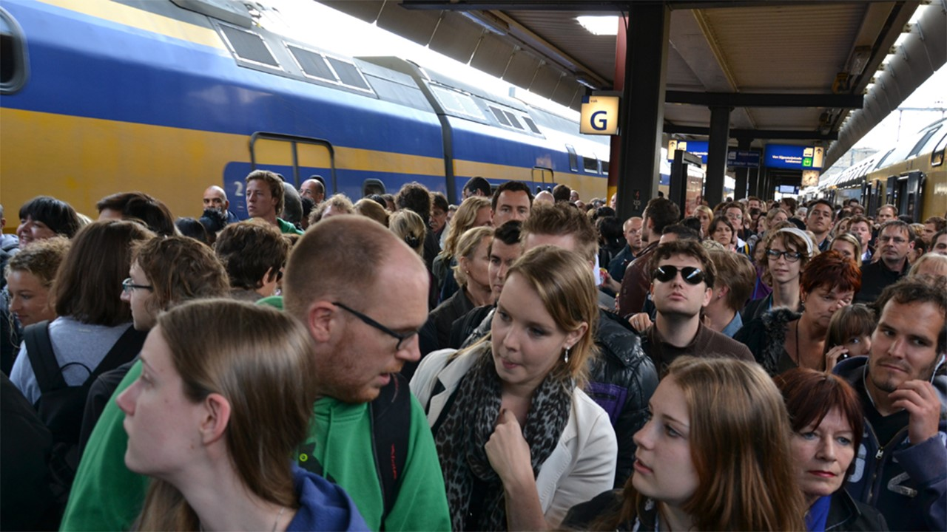
OTOBOX
“Rail should touch people’s hearts.”
Roger van Boxtel, CEO NS
On Time On Budget
On Xperience

Slide 25
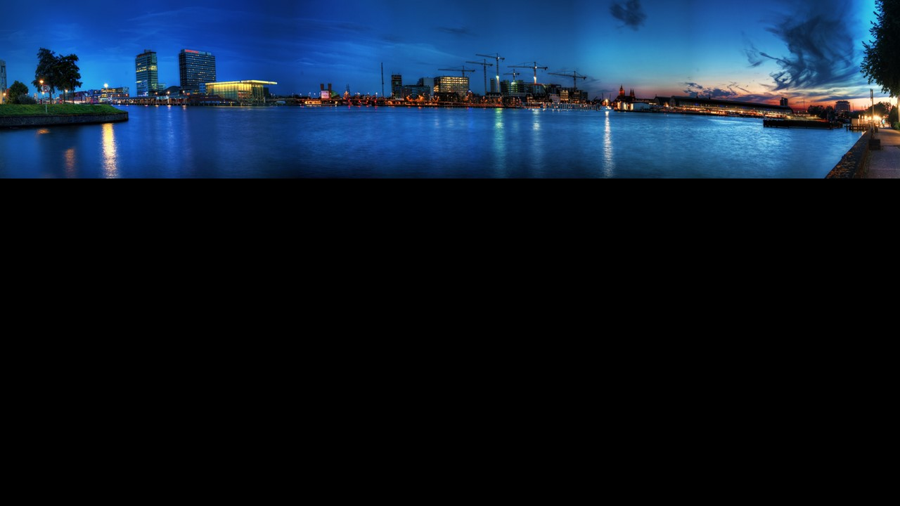
XLA City of Amsterdam
Problems
Availability
DevOps
Compliance
Satisfaction
Zero Repeat
Amsterdam Open
Successful in Production
Always Compliant
No
Hassle
Hosting business and web applications

Slide 26
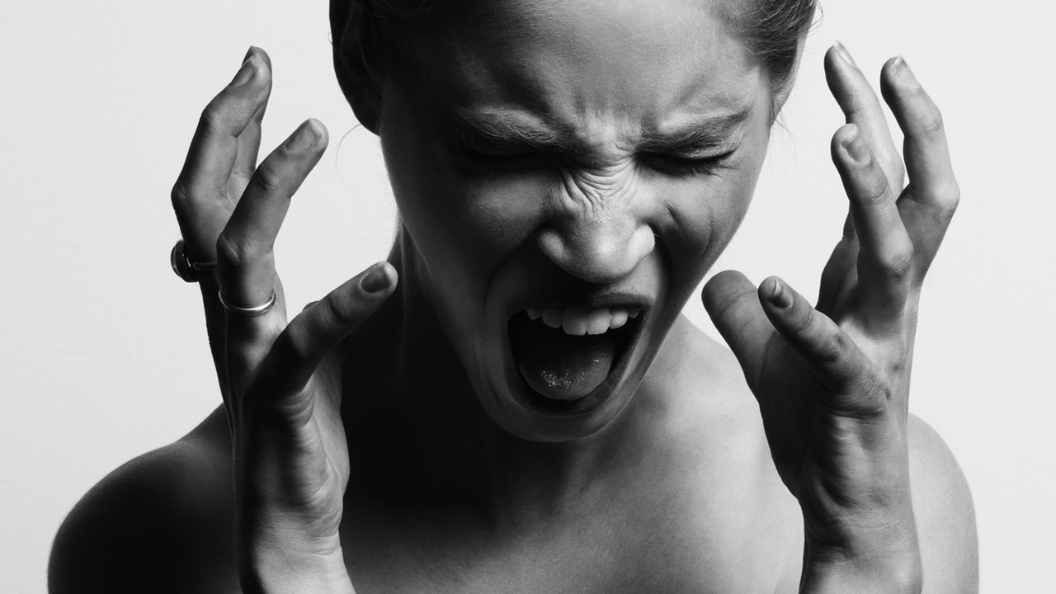
Behavior = Emotion
Punish
Angry
Threat
Fear
Neglect
Sad
Reward
Happy

Slide 27
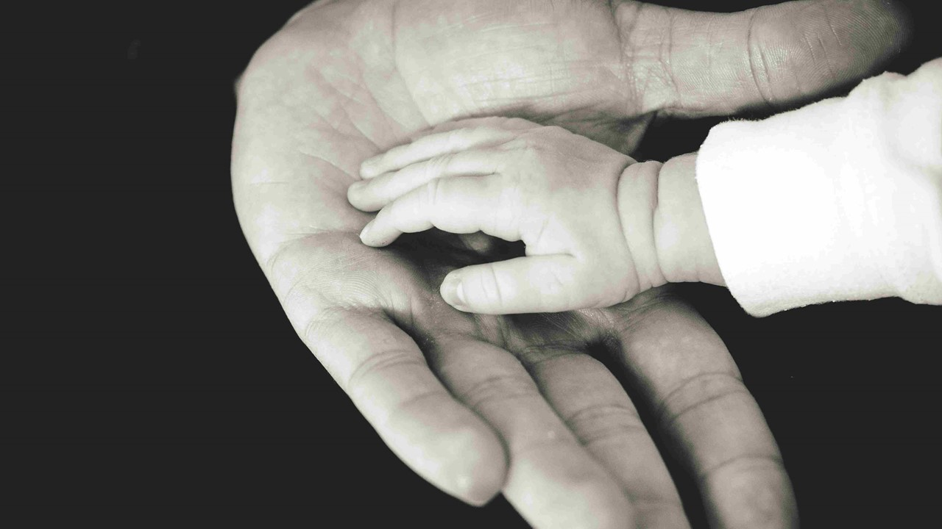
Emotions are biochemical algorithms

Slide 28
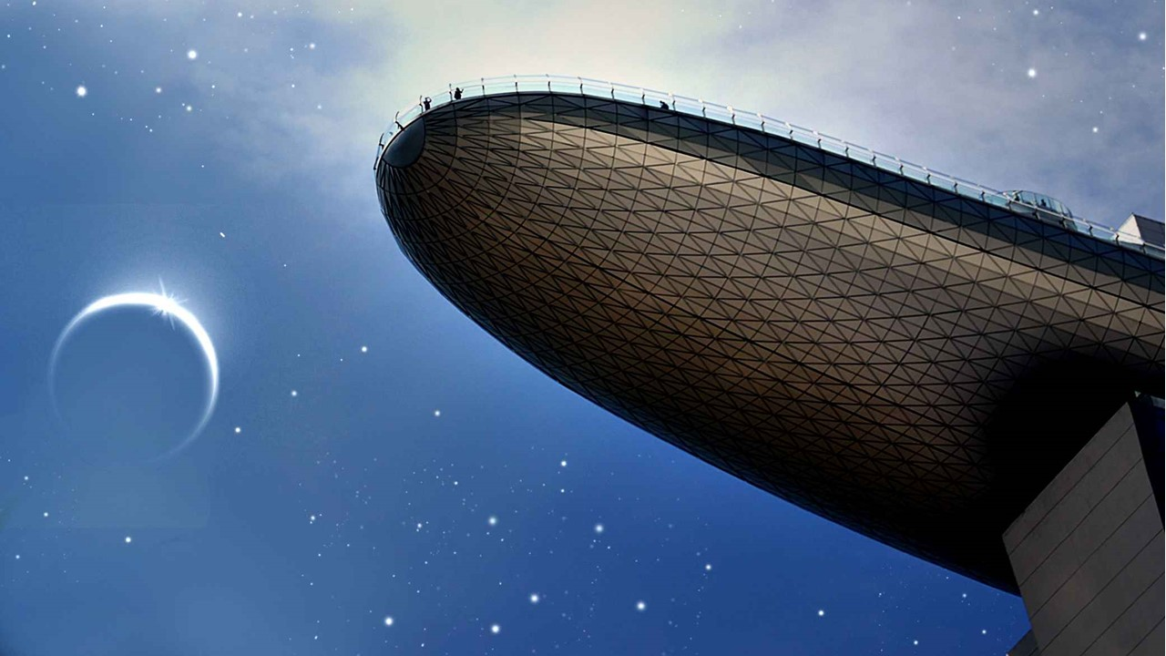
Awesome!
Cleanliness? Promptness?
Location?

Slide 29
Doing what you’re supposed to do
Doing what really matters
Satisfaction
Experience

Slide 30
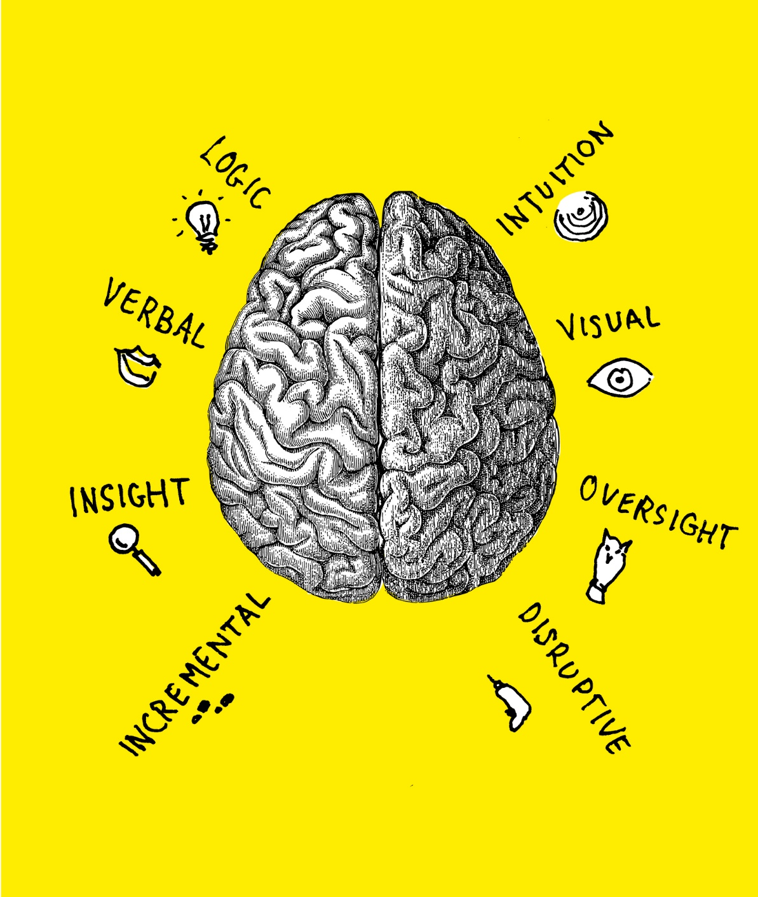
Left Brain
Right Brain

Slide 31
Ipu
We have one brain with two hemispheres. What really distinguishes both is not what they do but how they do the same things differently.
When you see ITSM as a brain, you need both…
SLA
XLA
Important Details
The Bigger Picture
Process First
Tangible Outputs
Technology Centric
Impact First
Valuable Outcomes
Human Centric
Notes:
All neural networks are asymmetric
Nematode worms: 302 neurons, >700 years old
Humans: 7,000,000,000 neurons (7 billion) 300,000 years old

Slide 32
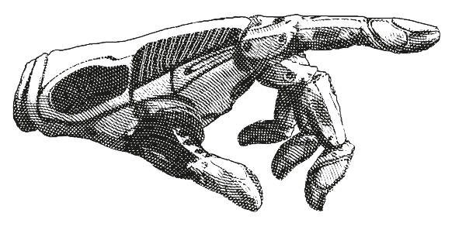
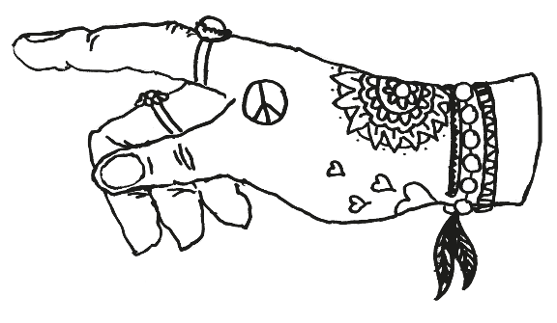
Reliability
Desirability
Functionality
Usability
Notes:
Desirability
Usability
Reliability
Functionality

Slide 33
Optimism
Love
Joy
Hope
SOLL
Trust
Aggression
Submission
Anger
Fear
Contempt
Awe
Disgust
Surprise
IST
Sadness
Remorse
Disproval
Notes:
Joy
Trust
Fear
Surprise
Sadness
Disgust
Anger
Hope
Love
Submission
Awe
Disproval
Remorse
Contempt
Agression
Optimism

Slide 34
DANSK
Optimisme
Kærlighed
Glæde
Håb
Tillid
Aggression
Lydighed
Følelsesmæssige trickere
Vrede
Frygt
Foragt
Ærefrygt
Afsky
Overraskelse
Tristhed
Anger
Misbilligelse
Notes:
Glæde
Tillid
Frygt
Overraskelse
Tristhed
Afsky
Anger
Håber
Kærlighed
Indsendelse
Awe
misbilligelse
Anger
Foragt
Aggression
Optimisme

Slide 35
The ability to
things and make decisions by yourself
The avoidance of unpleasantness in a service or product
SELF-RELIANCE
CONVENIENCE
HAPPINESS
The overall sense of well-being, joy, or contentment
Notes:
Desirability
Usability
Reliability
Functionality

Slide 36
Application Usage​
Application Happiness
Technology Rollouts
Landing Zones​
Workplace Performance​
Employee Engagement
Root Remedies
Hassle-free Support
Notes:
Desirability
Usability
Reliability
Functionality

Slide 37
Left Brain UX
Right Brain UX
How likely are you to recommend Windows 10 to a friend or colleague?
☐ Not at all likely
I need you to understand that people don’t have conversations where they randomly recommend operating systems to one another
Please explain why
you gave this score?
Notes:
Desirability
Usability
Reliability
Functionality

Slide 38
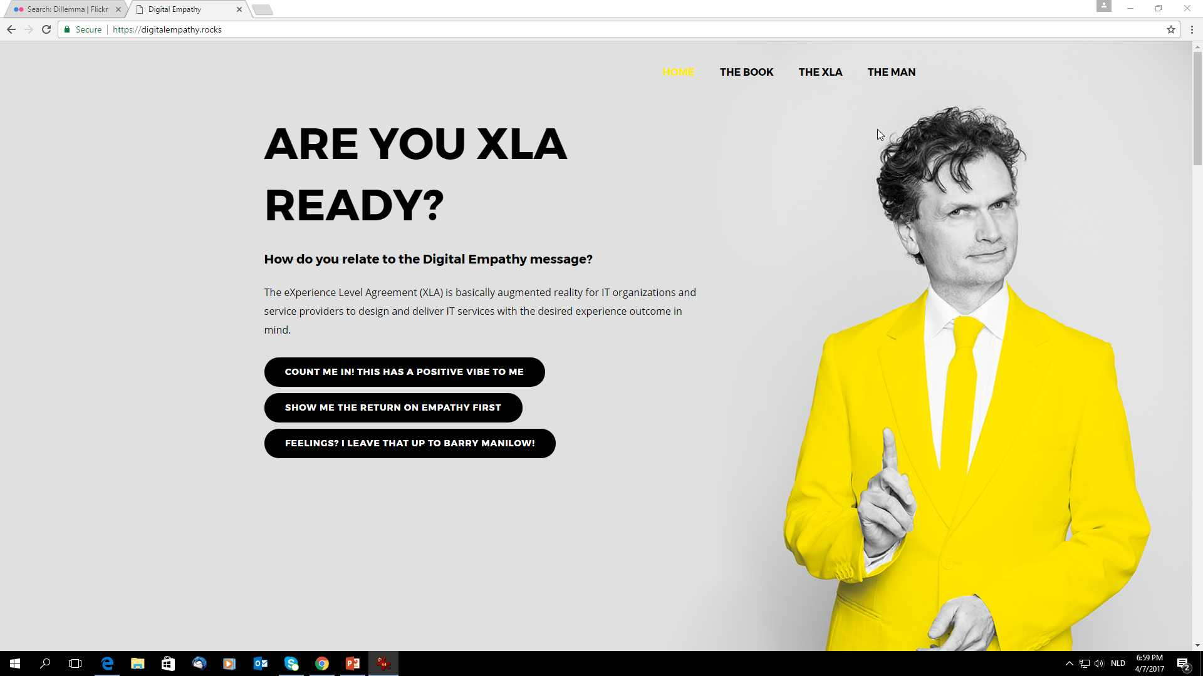

Slide 39
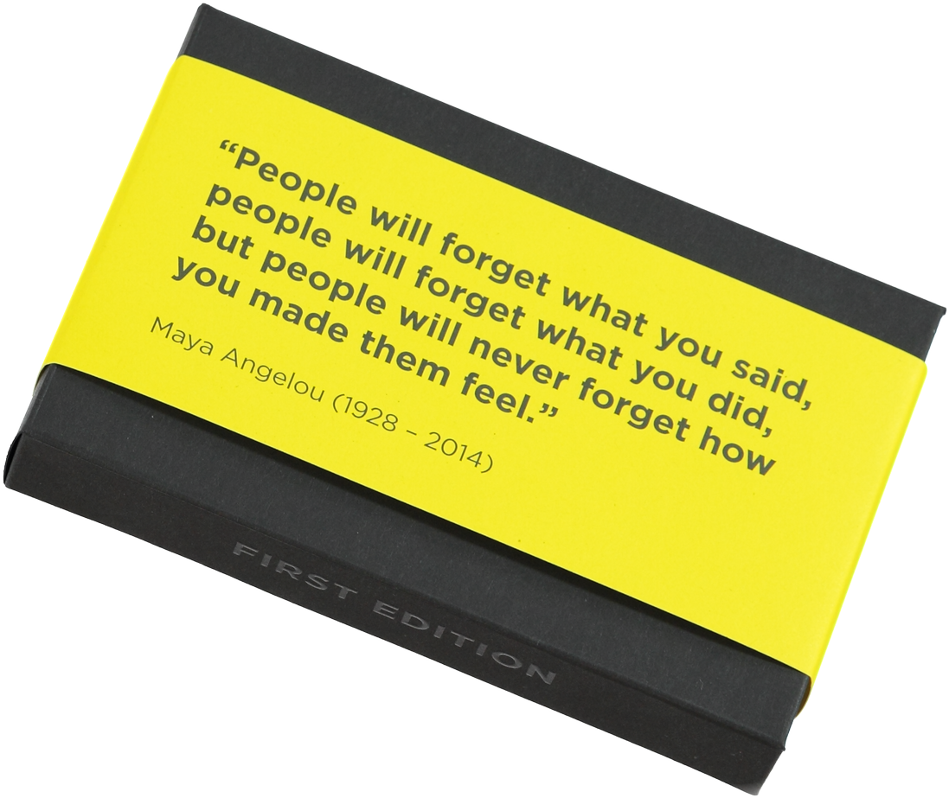

Slide 40
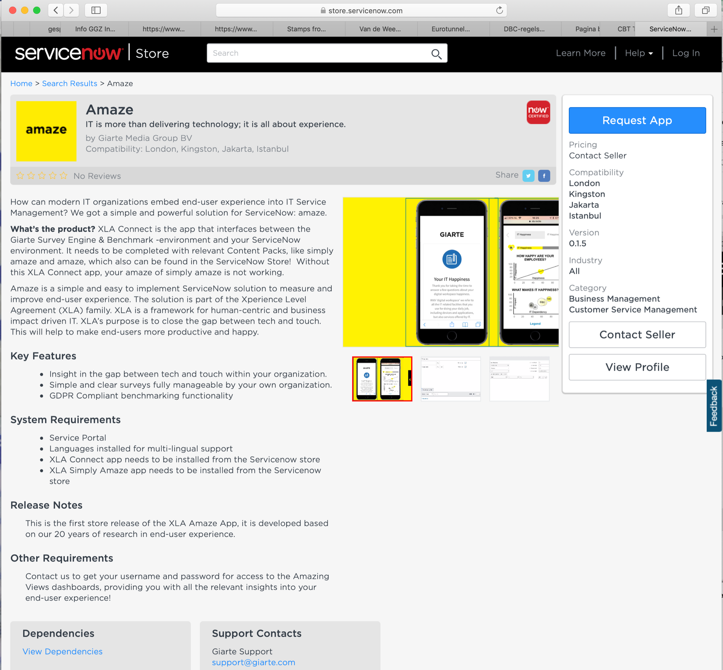
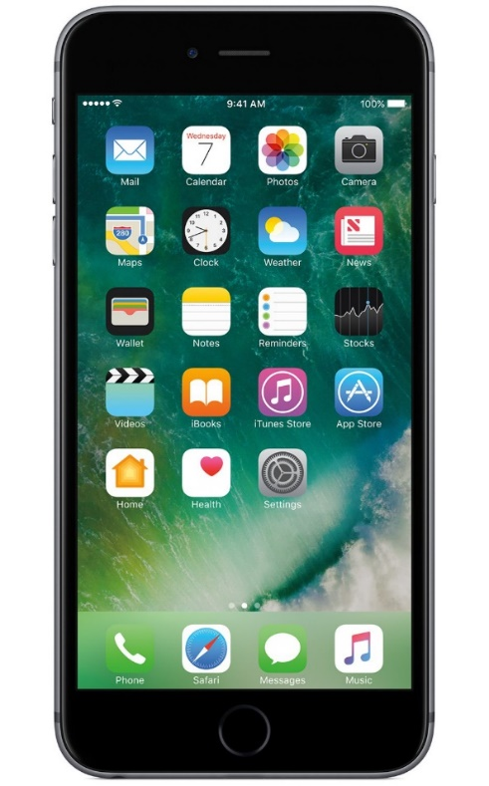

Slide 41
XLA
Philosophy
Movement
WHY
HOW
Methodology
WHAT

Slide 42
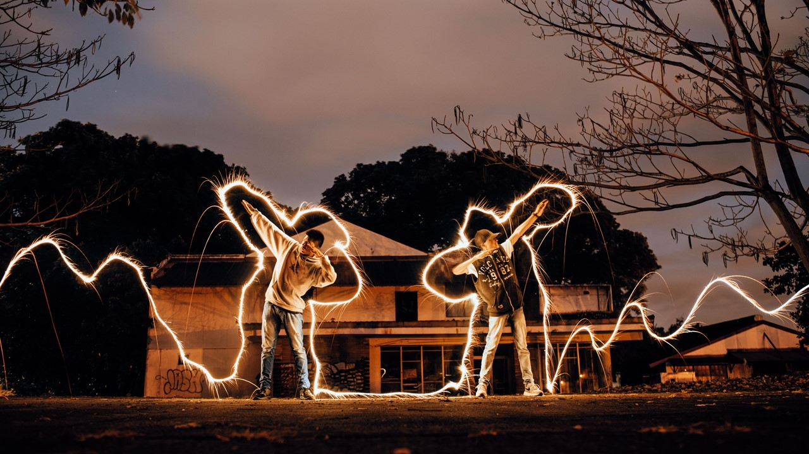
Focus on value
Think and work holistically
Keep it simple and practical
ITIL 4

Slide 43
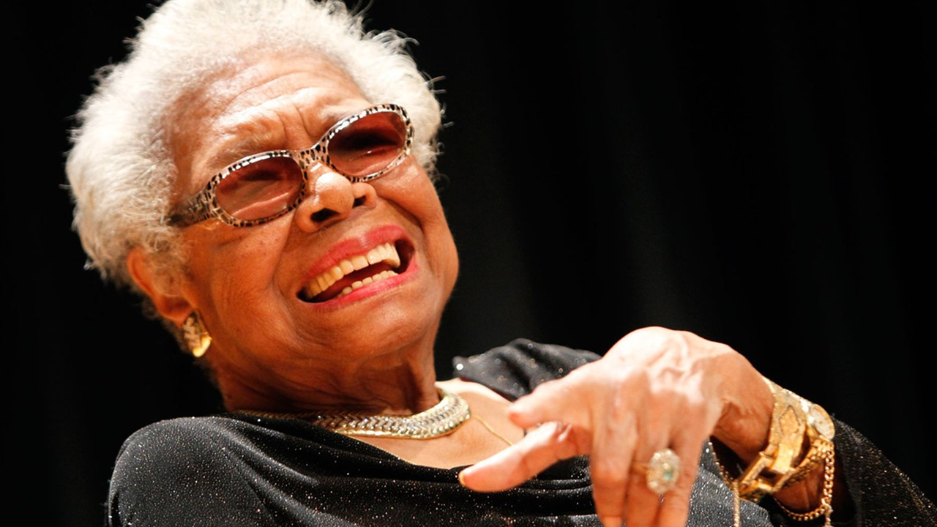
“People will forget what you said, people will forget what you did, but people will never forget how you made them feel.”
Maya Angelou
1928 – 2014

Slide 44
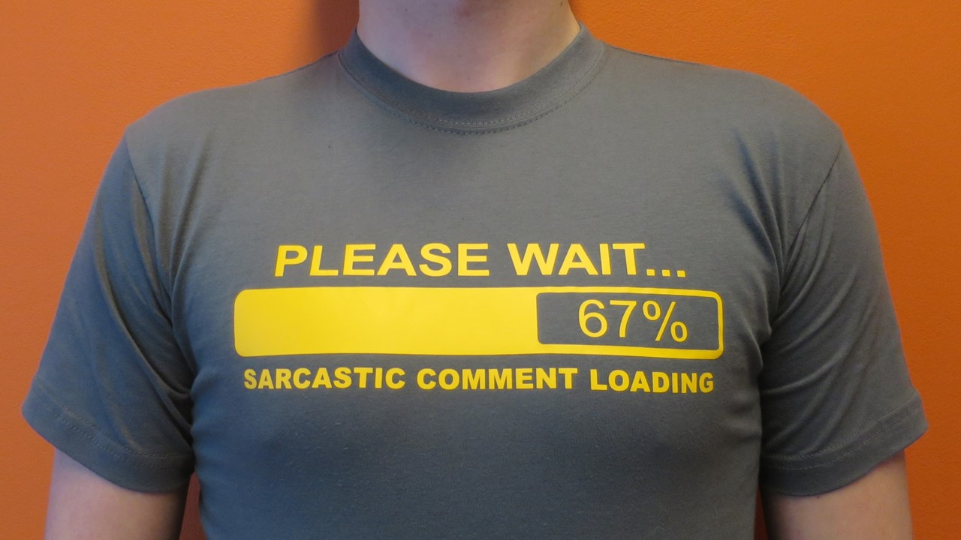
marco.gianotten@giarte.com

